Slide 1


A D PATEL INSTITUTE OF TECHNOLOGY
THE CHARUTAR VIDHYAMANDAL UNIVERSITY
DEPT. OF INFORMATION TECHNOLOGY ENG. A.Y.:2025-2
Design and Analysis of Algorithms
Mini Project on
PLAGIARISM DETECTION
Using String Matching: Naive • KMP • Rabin-Karp
Presented by :
Het Patel
IT – A
1C8
(12402080601043)

Slide 2
A D PATEL INSTITUTE OF TECHNOLOGY
THE CHARUTAR VIDHYAMANDAL UNIVERSITY
DEPT. OF INFORMATION TECHNOLOGY ENG. A.Y.:2025-26
Design and Analysis of Algorithms
INDEX
1. INTRODUCTION
2. PROBLEM STATEMENT
3. ALGORITHMS USED
4. SYSTEM WORKFLOW
5. FEATURES
6. COMPLEXITY ANALYSIS
7. KEY FUNCTIONS
3
4
5
6
7
8
9
8. SAMPLE OUTPUT
9. EXPERIMENTAL RESULTS
10. OBSERVATIONS
11. FUTURE SCOPE
12. CONCLUSION
13. REFERENCES
14. THANK YOU
10
11
12
13
14
15
16

Slide 3
A D PATEL INSTITUTE OF TECHNOLOGY
THE CHARUTAR VIDHYAMANDAL UNIVERSITY
DEPT. OF INFORMATION TECHNOLOGY ENG. A.Y.:2025-2
Design and Analysis of Algorithms
INTRODUCTION
Plagiarism means presenting someone else's words as your own without giving credit.
This DAA mini project detects it using three string matching algorithms: Naive, KMP and Rabin-Karp.
The suspect document is split into 5-word chunks, and each chunk is searched in the original document.
Similarity is the percentage of chunks found, and the algorithms are compared on time and comparisons.

Slide 4
A D PATEL INSTITUTE OF TECHNOLOGY
THE CHARUTAR VIDHYAMANDAL UNIVERSITY
DEPT. OF INFORMATION TECHNOLOGY ENG. A.Y.:2025-26
Design and Analysis of Algorithms
PROBLEM STATEMENT
Reading two documents side by side is slow and unreliable, especially for long texts.
Given an original text and a suspect text, the task is to find which parts of the suspect are copied.
The project also asks how the running time and character comparisons of each algorithm change as input grows.
Core Idea
Split + Search
————————
Count + Verdict
Similarity % = matched chunks / total chunks.

Slide 5
A D PATEL INSTITUTE OF TECHNOLOGY
THE CHARUTAR VIDHYAMANDAL UNIVERSITY
DEPT. OF INFORMATION TECHNOLOGY ENG. A.Y.:2025-26
Design and Analysis of Algorithms
ALGORITHMS USED
ALGORITHMS
TOOLS & MODULES
Naive (brute force) search
KMP with LPS table
Rabin-Karp rolling hash
Comparison counting
Chunk-based matching
Python 3
re (text cleaning)
time (perf_counter)
argparse (command line)
matplotlib (graphs)

Slide 6
A D PATEL INSTITUTE OF TECHNOLOGY
THE CHARUTAR VIDHYAMANDAL UNIVERSITY
DEPT. OF INFORMATION TECHNOLOGY ENG. A.Y.:2025-26
Design and Analysis of Algorithms
SYSTEM WORKFLOW
1
2
3
4
INPUT
CLEAN
SEARCH
REPORT
Two text files
Preprocess and chunk
Match each chunk
Score and verdict
The original and suspect documents are read from files.
Lowercase, remove symbols, split suspect into 5-word chunks.
Naive, KMP and Rabin-Karp search every chunk in the original.
Print similarity %, time, comparisons and the verdict.
Every run follows the same loop: input, clean, search, report.

Slide 7
A D PATEL INSTITUTE OF TECHNOLOGY
THE CHARUTAR VIDHYAMANDAL UNIVERSITY
DEPT. OF INFORMATION TECHNOLOGY ENG. A.Y.:2025-26
Design and Analysis of Algorithms
MAIN FEATURES
MODULE 1 | Document comparison
Compare an original and a suspect text file from the command line.
Set the chunk size with --chunk (default is 5 words).
Run all three algorithms on the same input for a fair comparison.
See similarity %, time, comparisons and the matched chunks.
Verdict scale
60% or more
HIGH plagiarism
30% to 59%
MODERATE
Below 30%
LOW / original

Slide 8
A D PATEL INSTITUTE OF TECHNOLOGY
THE CHARUTAR VIDHYAMANDAL UNIVERSITY
DEPT. OF INFORMATION TECHNOLOGY ENG. A.Y.:2025-26
Design and Analysis of Algorithms
COMPLEXITY ANALYSIS
DAA | n = text length, m = pattern length
Naive checks every position, so its worst case is O(n·m).
KMP uses the LPS table and never moves back in the text: O(n+m).
Rabin-Karp compares hashes first, but many hash hits can reach O(n·m).
Space: Naive and Rabin-Karp use O(1), KMP uses O(m) for the LPS table.
Worst case
Naive : O(n·m)
KMP : O(n+m)
Rabin-Karp : O(n·m)
Average (all) : O(n+m)

Slide 9
A D PATEL INSTITUTE OF TECHNOLOGY
THE CHARUTAR VIDHYAMANDAL UNIVERSITY
DEPT. OF INFORMATION TECHNOLOGY ENG. A.Y.:2025-26
Design and Analysis of Algorithms
KEY FUNCTIONS
ALGORITHMS.PY and PLAGIARISM.PY
naive_search(), kmp_search() and rabin_karp_search() return (matches, comparisons).
build_lps() creates the prefix table that KMP uses.
preprocess() and make_chunks() clean the text and split it into chunks.
check() runs all three algorithms and builds the similarity report.
Modular design
8
FUNCTIONS
Each function has one clear job.

Slide 10
A D PATEL INSTITUTE OF TECHNOLOGY
THE CHARUTAR VIDHYAMANDAL UNIVERSITY
DEPT. OF INFORMATION TECHNOLOGY ENG. A.Y.:2025-26
Design and Analysis of Algorithms
SAMPLE OUTPUT
RUN | suspect_high.txt vs original.txt
14 chunks checked and 11 matched, so all three algorithms report 78.6% similarity.
Verdict is HIGH plagiarism, since the score is above 60%.
suspect_low.txt gives 0.0% similarity and the verdict LOW / original.
Rabin-Karp needed only 334 comparisons, while Naive needed 9378.
Comparisons
Naive
9378
KMP
9307
Rabin-Karp
334

Slide 11
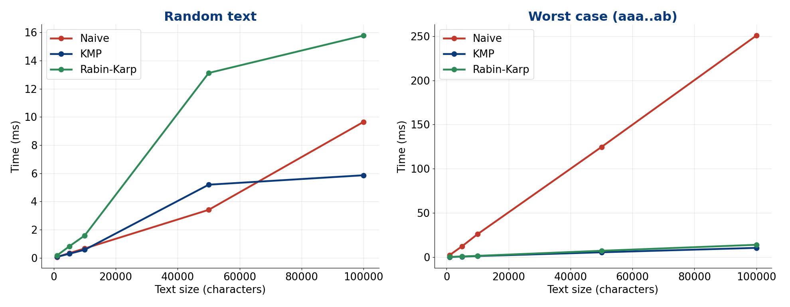
A D PATEL INSTITUTE OF TECHNOLOGY
THE CHARUTAR VIDHYAMANDAL UNIVERSITY
DEPT. OF INFORMATION TECHNOLOGY ENG. A.Y.:2025-26
Design and Analysis of Algorithms
EXPERIMENTAL RESULTS

Slide 12
A D PATEL INSTITUTE OF TECHNOLOGY
THE CHARUTAR VIDHYAMANDAL UNIVERSITY
DEPT. OF INFORMATION TECHNOLOGY ENG. A.Y.:2025-26
Design and Analysis of Algorithms
OBSERVATIONS
NAIVE
Slow in the worst case
Takes 250.8 ms on 100,000 characters of aaa..ab text.
KMP
Fastest in the worst case
Takes 10.4 ms on the same input, because it never re-reads text.
RABIN
Fewest comparisons
Only 334 character checks on the sample, but hashing adds time in Python.
RANDOM
All three are close
On random text Naive and KMP stay close; Rabin-Karp is slower due to hashing.

Slide 13
A D PATEL INSTITUTE OF TECHNOLOGY
THE CHARUTAR VIDHYAMANDAL UNIVERSITY
DEPT. OF INFORMATION TECHNOLOGY ENG. A.Y.:2025-26
Design and Analysis of Algorithms
FUTURE SCOPE
Detect paraphrased text using edit distance or Longest Common Subsequence.
Use sliding word windows instead of fixed chunks to catch shifted copies.
Use multi-pattern search such as Aho-Corasick to check many sources at once.
Support PDF and Word files and highlight the matched text in the output.

Slide 14
A D PATEL INSTITUTE OF TECHNOLOGY
THE CHARUTAR VIDHYAMANDAL UNIVERSITY
DEPT. OF INFORMATION TECHNOLOGY ENG. A.Y.:2025-26
Design and Analysis of Algorithms
CONCLUSION
The project detects copied text and reports a similarity percentage and a verdict.
All three algorithms give the same similarity (78.6% on the high sample), so their results agree.
KMP is the safest choice in the worst case, while Rabin-Karp makes the fewest comparisons.
Algorithm choice matters more as the input grows, which shows why DAA analysis is useful.

Slide 15
A D PATEL INSTITUTE OF TECHNOLOGY
THE CHARUTAR VIDHYAMANDAL UNIVERSITY
DEPT. OF INFORMATION TECHNOLOGY ENG. A.Y.:2025-26
Design and Analysis of Algorithms
REFERENCES
1. Cormen, Leiserson, Rivest, Stein: Introduction to Algorithms (CLRS)
Chapter 32: String Matching
2. GeeksforGeeks: KMP algorithm for pattern searching
https://www.geeksforgeeks.org/kmp-algorithm-for-pattern-searching/
3. GeeksforGeeks: Rabin-Karp algorithm for pattern searching
https://www.geeksforgeeks.org/rabin-karp-algorithm-for-pattern-searching/
4. Python Documentation: re, regular expression operations
https://docs.python.org/3/library/re.html
5. Python Documentation: time, time access and conversions
https://docs.python.org/3/library/time.html

Slide 16
A D PATEL INSTITUTE OF TECHNOLOGY
THE CHARUTAR VIDHYAMANDAL UNIVERSITY
DEPT. OF INFORMATION TECHNOLOGY ENG. A.Y.:2025-26
Design and Analysis of Algorithms
THANK YOU !
Questions and discussion

